Slide 1
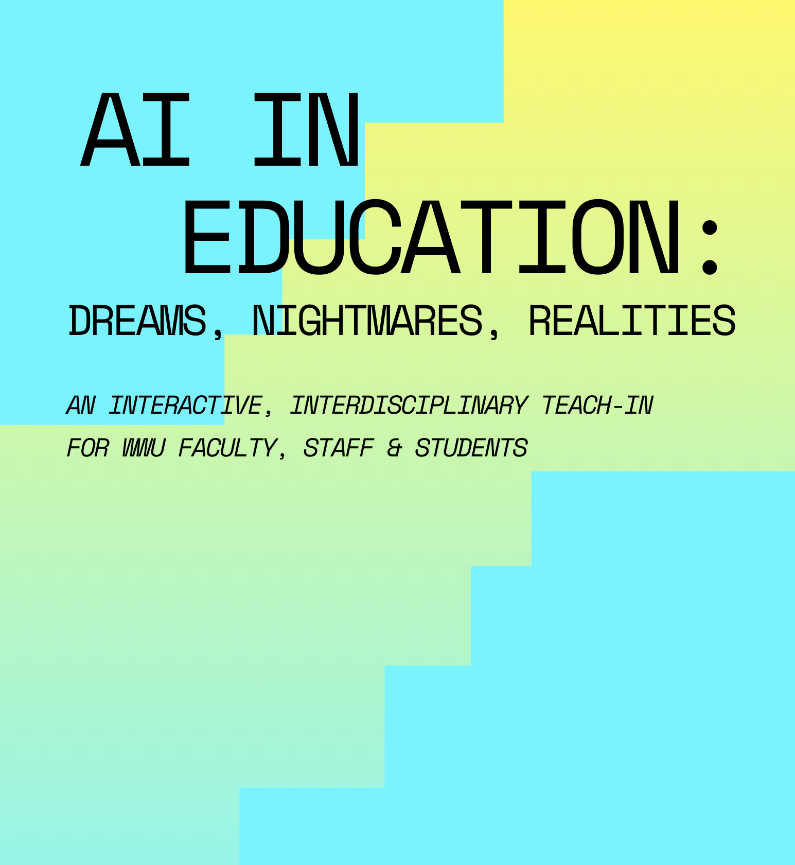

TODAY’S PRESENTERS:
Jenny Forsythe (English)
Amites Sarkar (Math)
Emily Spraklin (Library Services)
Claudia Johnson (Fairhaven)
Xi Wang (Environmental Studies and Energy Studies)
With help from:
Aspen Clark (ITS)
Robyn Dahl (Geology & SMATE)
Brianna Delker (Psychology)
Christine Johnson (History)

Slide 2
Please introduce yourself to your neighbors!
Name
Pronouns, if you want
What you do at WWU
How you heard about this event
Why you are here

Slide 3
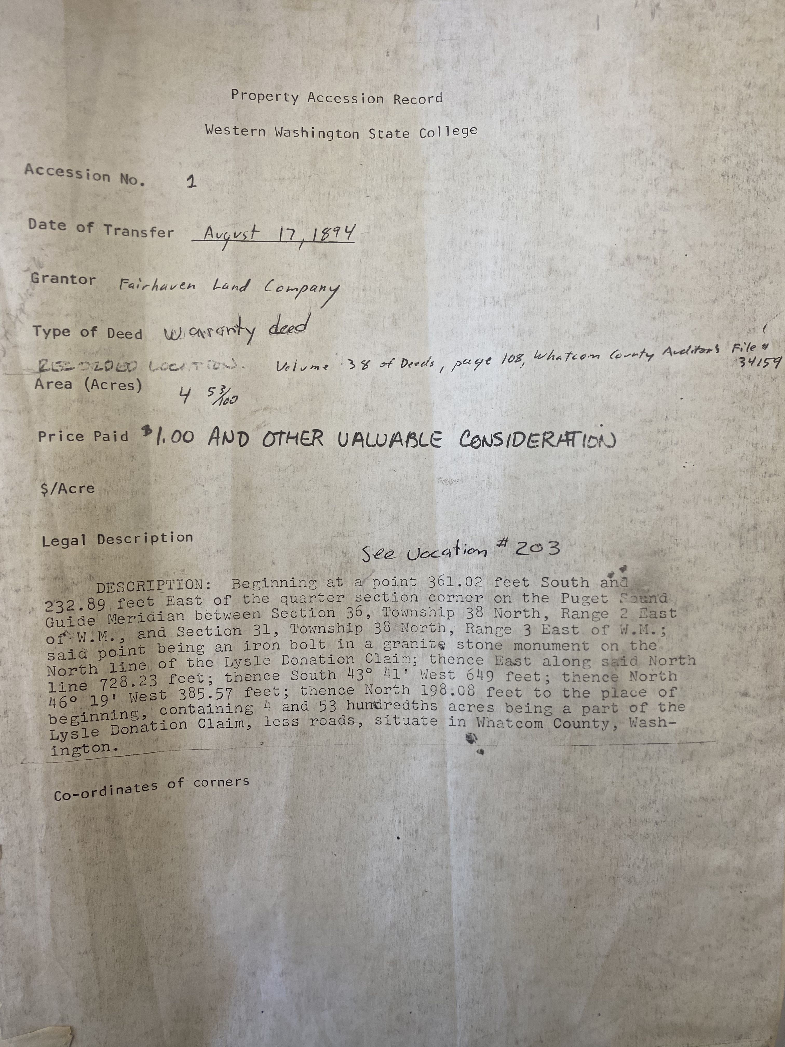
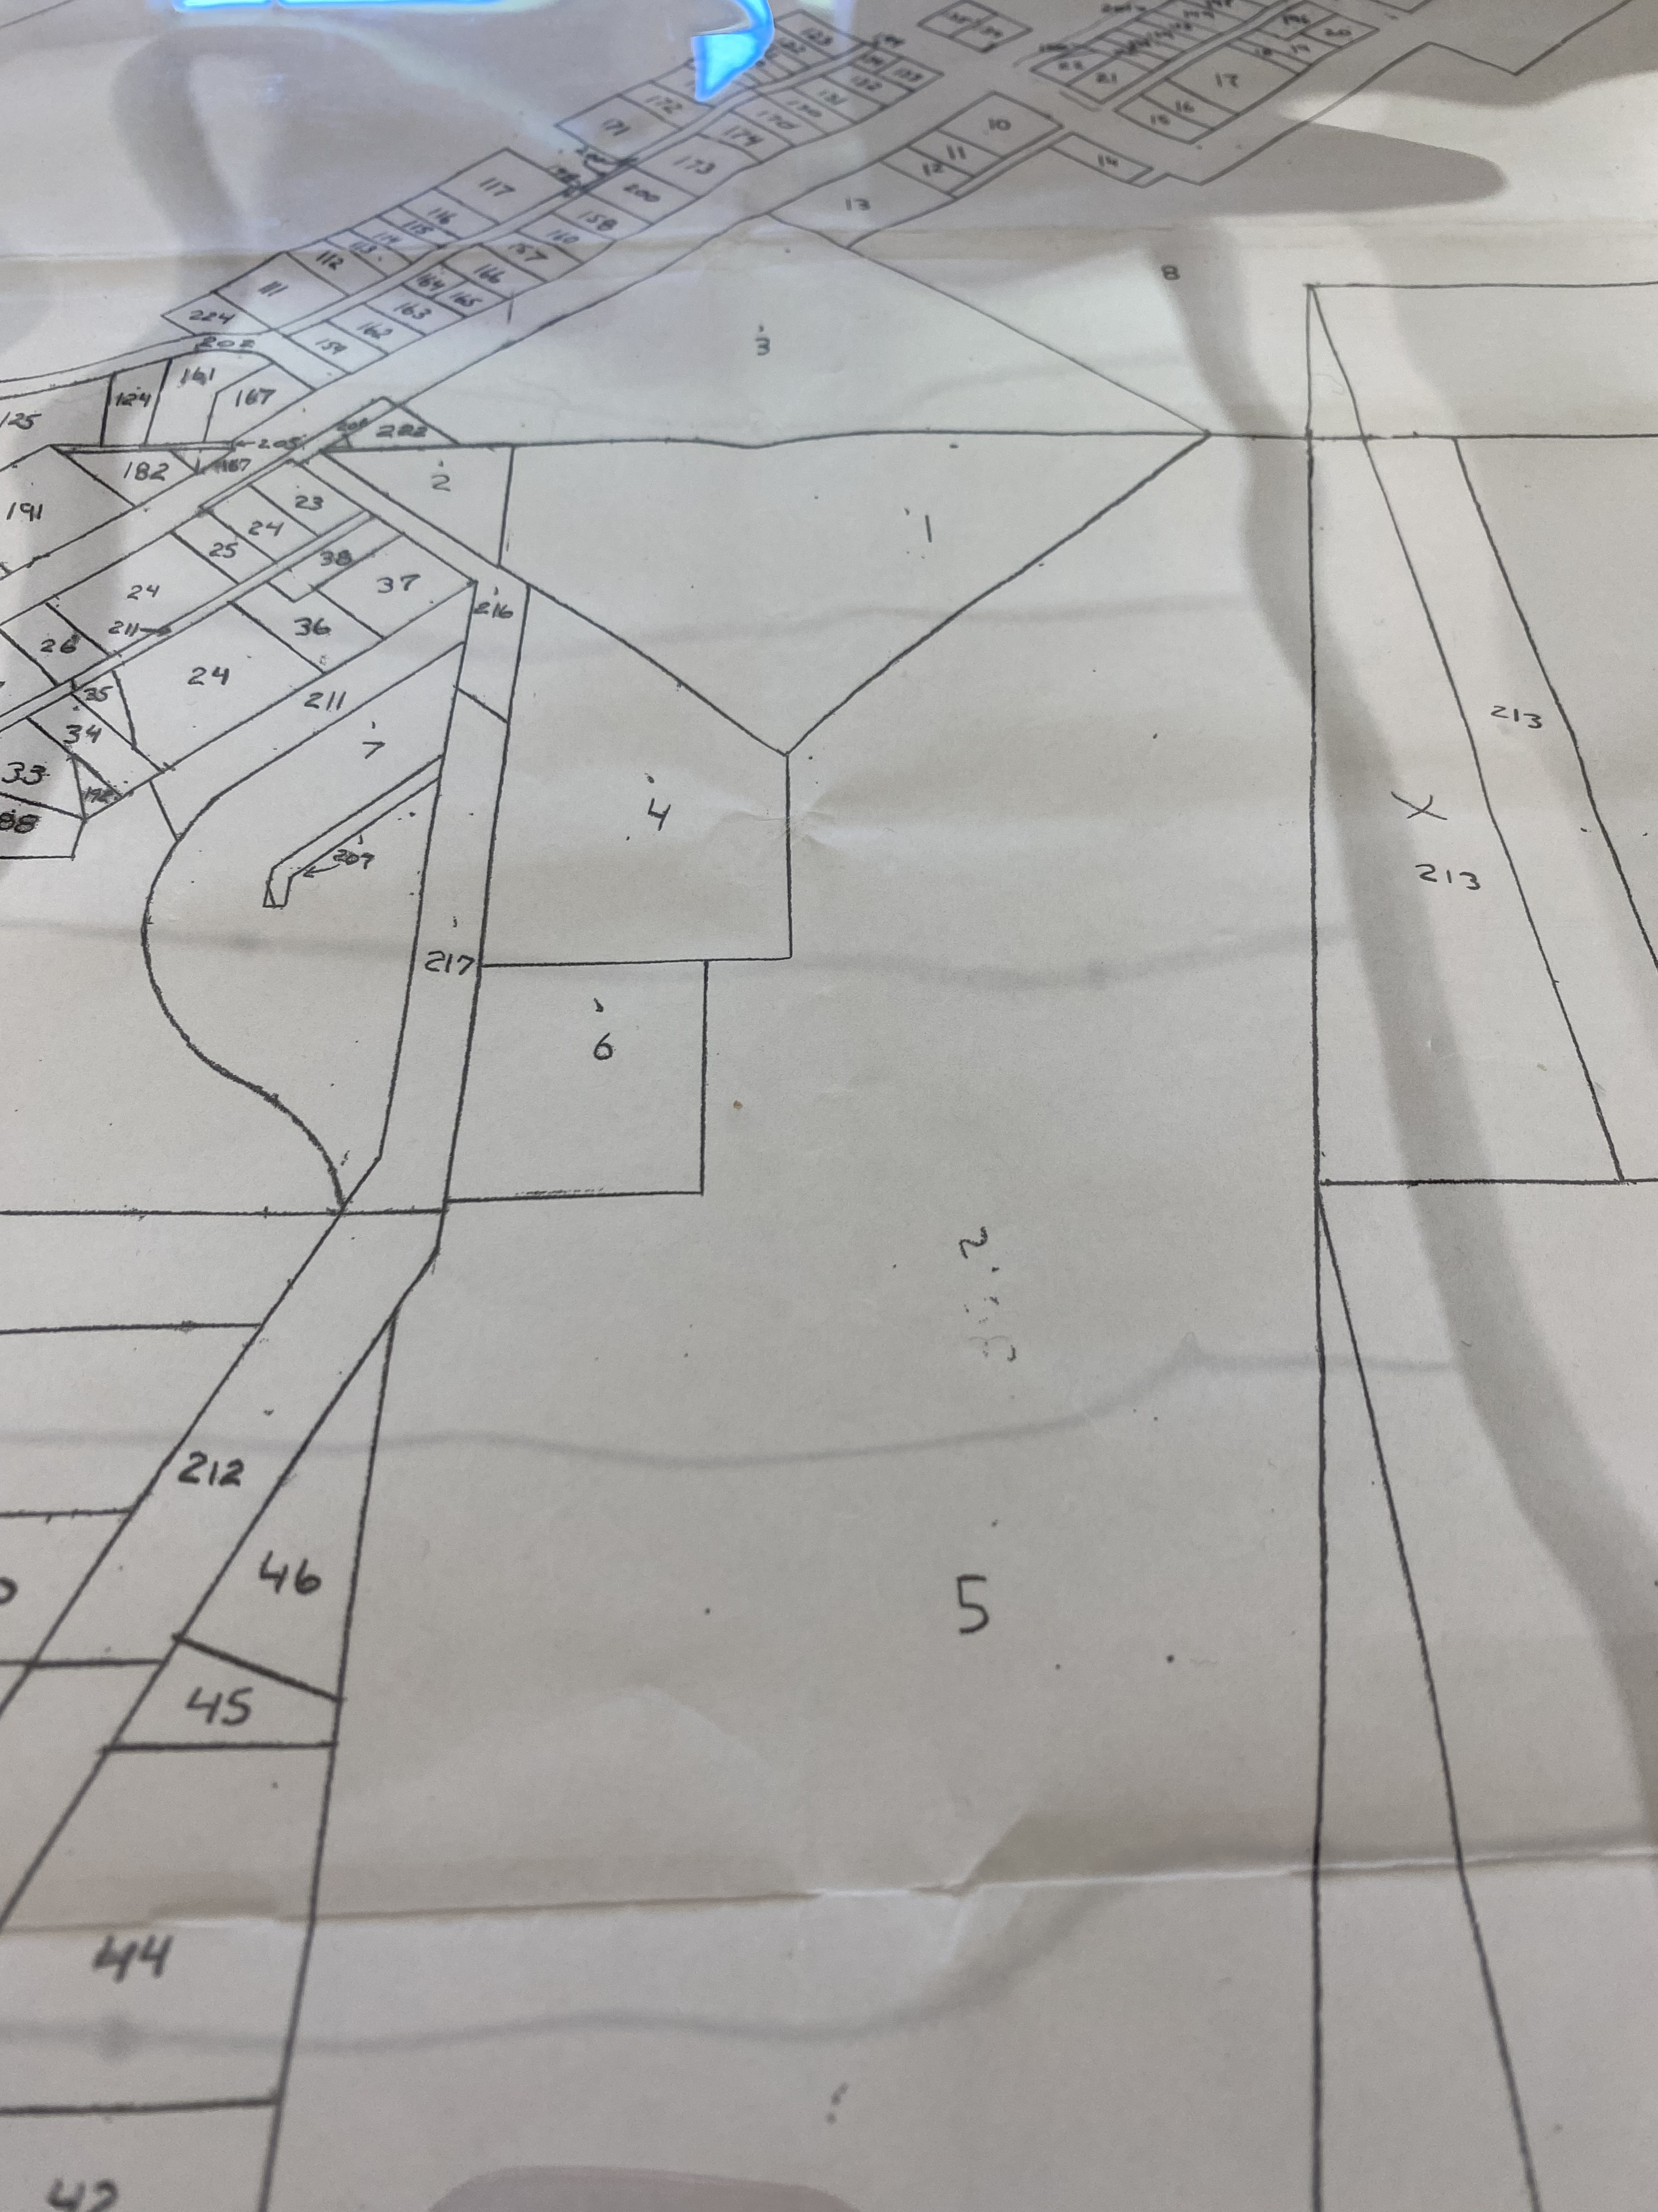
Property Accession Record Western Washington State College Accession No. 1." August 17, 1894. Land Acquisition Files Property Accession Records Binders #1 (1 through 163) and #2 (164 through 272). 2013-122. Box 5. 1155. University Archives and Records Management, Western Washington University, Bellingham, WA.
Detail of Parcel Map E1294." Date Unknown. Property Accession Records Binder #1. 2013-122. Box 5. University Archives and Records Management, Western Washington University, Bellingham, WA.

Slide 4
Opening Remarks Citations
Western Washington University Tribal Lands Statement. https://www.wwu.edu/tribal-lands-statement
Cerretti, Josh. “Bellingham from Below Virtual Tour.” November 1, 2021. Talking to Crows. Youtube. https://www.youtube.com/watch?v=5zDmQ8KBo2E&t=67s
"Detail of Parcel Map E1294." Date Unknown. Property Accession Records Binder #1. 2013-122. Box 5. University Archives and Records Management, Western Washington University, Bellingham, WA.
"Property Accession Record Western Washington State College Accession No. 1." August 17, 1894. Land Acquisition Files Property Accession Records Binders #1 (1 through 163) and #2 (164 through 272). 2013-122. Box 5. 1155. University Archives and Records Management, Western Washington University, Bellingham, WA.
Hubbard, Steven. “ICE to Use ImmigrationOS by Palantir, a New AI System, to Track Immigrants’ Movements.” August 21, 2025. American Immigration Council. https://www.americanimmigrationcouncil.org/blog/ice-immigrationos-palantir-ai-track-immigrants/
Israel has committed genocide in the Gaza Strip, UN Commission finds. September 16, 2025. United Nations Office of the High Commissioner on Human Rights. https://www.ohchr.org/en/press-releases/2025/09/israel-has-committed-genocide-gaza-strip-un-commission-finds
“Israel/OPT: Israeli organizations conclude Israel committing genocide against Palestinians in Gaza in another milestone for accountability efforts.” Amnesty International. July 28, 2025. https://www.amnesty.org/en/latest/news/2025/07/israel-opt-israeli-organizations-conclude-israel-committing-genocide-against-palestinians-in-gaza-in-another-milestone-for-accountability-efforts/
The GREAT (Gaza Reconstitution Economic Acceleration and Transformation) Trust. Washington Post. 2025. https://www.washingtonpost.com/documents/f86dd56a-de7f-4943-af4a-84819111b727.pdf
Gross, Terry. How 'modern-day slavery' in the Congo powers the rechargeable battery economy. February 1, 2023. Fresh Air. https://www.npr.org/sections/goatsandsoda/2023/02/01/1152893248/red-cobalt-congo-drc-mining-siddharth-kara
“Elon Musk’s xAI facility is using gas turbines in South Memphis, we’re taking action.” June 17, 2025. Southern Environmental Law Center. https://www.selc.org/news/resistance-against-elon-musks-xai-facility-in-south-memphis-gets-stronger/
Hao, Karen. Empire of AI. Dreams and Nightmares in Sam Altman’s Open AI. Penguin Press, 2025.
Washington State Office of the Attorney General. “Artificial Intelligence Task Force.” 2024-present. ATG.gov. https://www.atg.wa.gov/aitaskforce
Lubell, Jennifer. “How AI is leading to more prior authorization denials.” March 10, 2025. American Medical Association website. https://www.ama-assn.org/practice-management/prior-authorization/how-ai-leading-more-prior-authorization-denials

Slide 5
LLMs: How they Work and Why it Matters
AI in Education: Dreams, Nightmares, Realities
October 5, 2025

Slide 6

Algorithm

Slide 7
Algorithm A precise set of step-by-step instructions

Slide 8
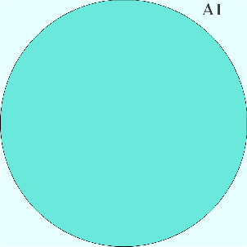
Algorithm A precise set of step-by-step instructions
AI

Slide 9
Algorithm A precise set of step-by-step instructions
AI An algorithm for a computer to do something that, for a person, would require thought

Slide 10
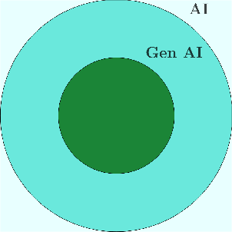
Algorithm A precise set of step-by-step instructions
AI An algorithm for a computer to do something that, for a person, would require thought
Generative AI

Slide 11
Algorithm A precise set of step-by-step instructions
AI An algorithm for a computer to do something that, for a person, would require thought
Generative AI AI that generates something new (image, video etc)

Slide 12
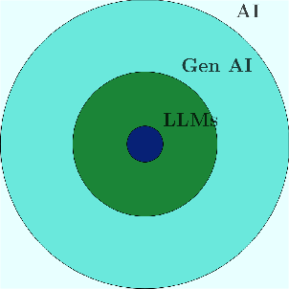
Algorithm A precise set of step-by-step instructions
AI An algorithm for a computer to do something that, for a person, would require thought
Generative AI AI that generates something new (image, video etc)
LLM

Slide 13
Algorithm A precise set of step-by-step instructions
AI An algorithm for a computer to do something that, for a person, would require thought
Generative AI AI that generates something new (image, video etc)
LLM AI that generates text

Slide 14


Algorithm A precise set of step-by-step instructions
AI An algorithm for a computer to do something that, for a person, would require thought
Generative AI AI that generates something new (image, video etc)
LLM AI that generates text

Slide 15
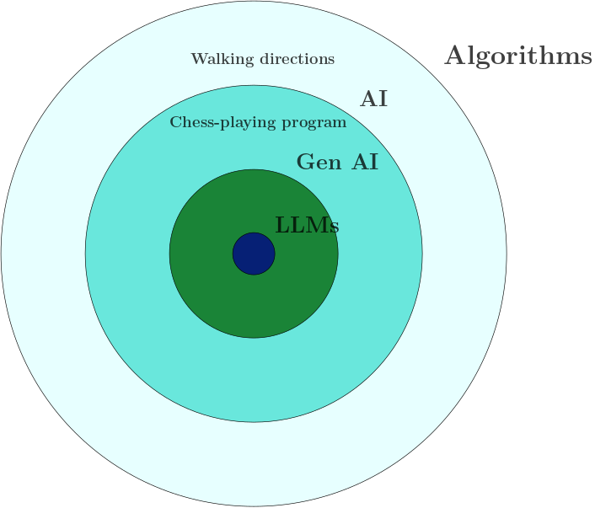
Algorithm A precise set of step-by-step instructions
AI An algorithm for a computer to do something that, for a person, would require thought
Generative AI AI that generates something new (image, video etc)
LLM AI that generates text

Slide 16
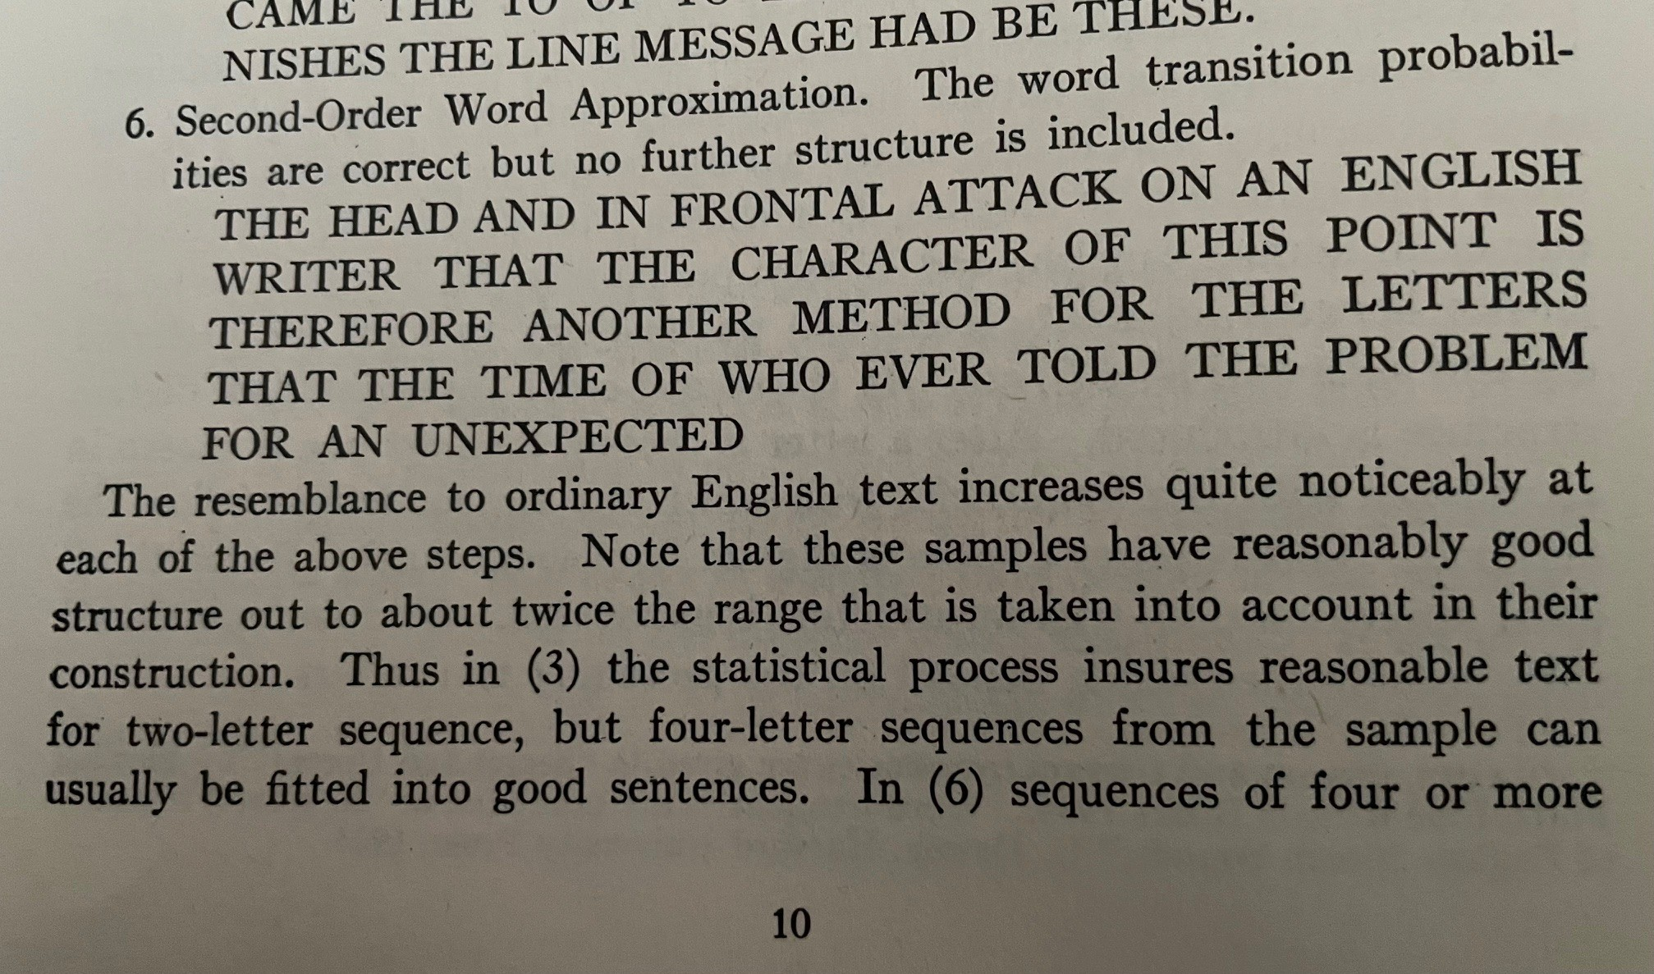
A Mathematical Theory of Communication (1948)
Most of the ideas behind LLMs are not new.
A key idea was described by Claude Shannon in 1948.
Here is an extract from his paper.

Slide 17

What did Shannon do?

Slide 18
What did Shannon do?
Start with the word “The”.
Choose a book. (Shannon doesn’t say which book he used.)
Open the book to a random page.
Find the first occurrence of the word ”The” on that page.
Write down the next word (in this case “head”).
Open the book to another random page.
Find the first occurrence of the word ”head” on that page.
(If it’s not on that page, keep going.)
Write down the next word (in this case “and”). Repeat.
Instead of leaving things to chance
you can just choose the most likely word.

Slide 19
In other words
dog 0.034
The cat
0.027
pig 0.005

Slide 20
In other words
dog 0.034
The cat
0.027
pig 0.005
Shannon used a training text (an unnamed book),
and a sentence fragment (“The head and”),
to predict just the next word in the sentence,
based on word pair frequencies in the book.
Large language models do the same thing,
but instead of one unnamed book,

Slide 21
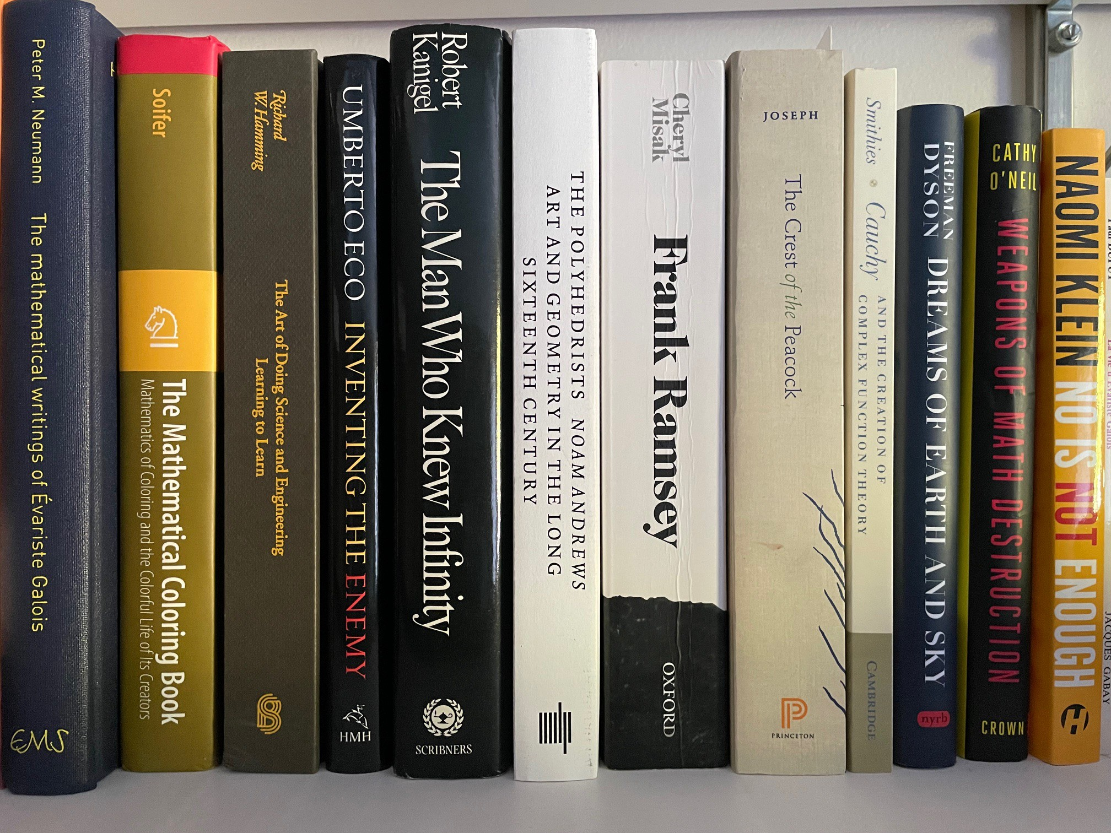
In other words
dog 0.034
The cat 0.027
pig 0.005
Shannon used a training text (an unnamed book),
and a sentence fragment (“The head and”),
to predict just the next word in the sentence,
based on word pair frequencies in the book.
Large language models do the same thing,
but instead of one unnamed book,
they use many unnamed texts
(usually without permission)
and instead of word pair frequencies

Slide 22
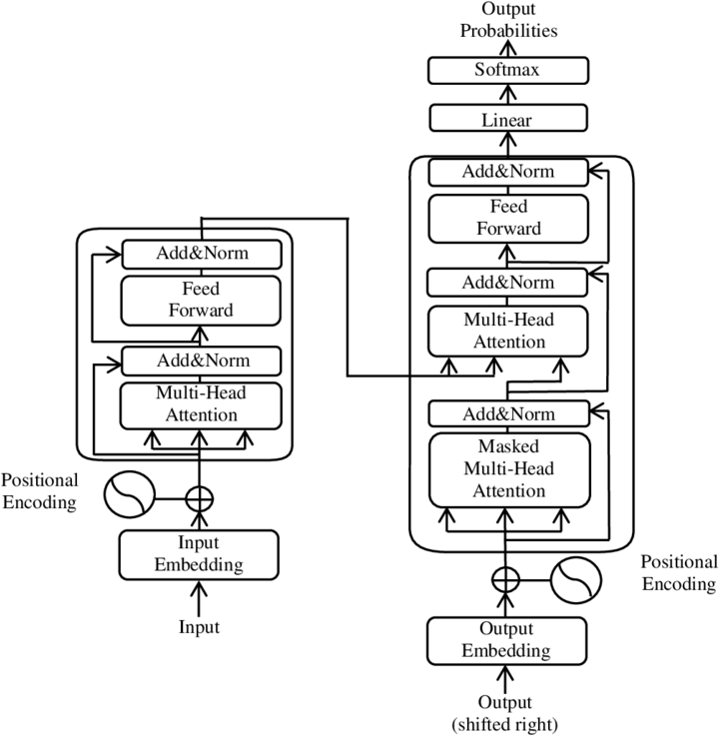
In other words
Shannon used a training text (an unnamed book),
and a sentence fragment (“The head and”),
to predict just the next word in the sentence,
based on word pair frequencies in the book.
Large language models do the same thing,
but instead of one unnamed book,
they use many unnamed texts
(usually without permission)
and instead of word pair frequencies
they do something much more fancy,
but they’re still just predicting the next word.

Slide 23
What are LLMs good for?

Slide 24
What are LLMs good for?
Searching a large database of texts.
Finding patterns in a large database of texts.
Summarizing patterns in a large database of texts.
Writing a poem on the subject of the free market.
Based on how LLMs work, none of this is particularly surprising.
But
LLMs sound like the truth,
but they are just summarizing biases in their training data,
and using them will only perpetuate these biases.
These biases are unconscious for the LLM and for the user.
LLMs have no direct relationship with the truth.

Slide 25
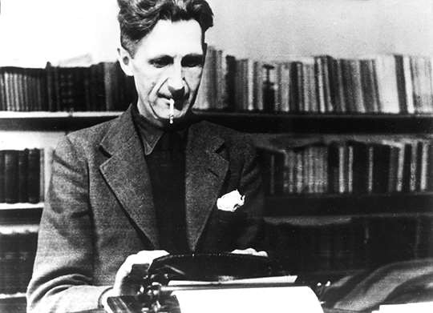
Politics and the English Language (1946)

Slide 26
Politics and the English Language (1946)
As I have tried to show, modern writing at its worst does not consist in picking out words for the sake of their meaning and inventing images in order to make the meaning clearer.

Slide 27
Politics and the English Language (1946)
As I have tried to show, modern writing at its worst does not consist in picking out words for the sake of their meaning and inventing images in order to make the meaning clearer. It consists in gumming together long strips of words which have already been set in order by someone else,

Slide 28
Politics and the English Language (1946)
As I have tried to show, modern writing at its worst does not consist in picking out words for the sake of their meaning and inventing images in order to make the meaning clearer. It consists in gumming together long strips of words which have already been set in order by someone else, and making the results presentable by sheer humbug.

Slide 29
Politics and the English Language (1946)
As I have tried to show, modern writing at its worst does not consist in picking out words for the sake of their meaning and inventing images in order to make the meaning clearer. It consists in gumming together long strips of words which have already been set in order by someone else, and making the results presentable by sheer humbug. The attraction of this way of writing is that it is easy.

Slide 30
Politics and the English Language (1946)
As I have tried to show, modern writing at its worst does not consist in picking out words for the sake of their meaning and inventing images in order to make the meaning clearer. It consists in gumming together long strips of words which have already been set in order by someone else, and making the results presentable by sheer humbug. The attraction of this way of writing is that it is easy.
What am I trying to say?

Slide 31
Politics and the English Language (1946)
As I have tried to show, modern writing at its worst does not consist in picking out words for the sake of their meaning and inventing images in order to make the meaning clearer. It consists in gumming together long strips of words which have already been set in order by someone else, and making the results presentable by sheer humbug. The attraction of this way of writing is that it is easy.
What am I trying to say? What words will express it?

Slide 32
Politics and the English Language (1946)
As I have tried to show, modern writing at its worst does not consist in picking out words for the sake of their meaning and inventing images in order to make the meaning clearer. It consists in gumming together long strips of words which have already been set in order by someone else, and making the results presentable by sheer humbug. The attraction of this way of writing is that it is easy.
What am I trying to say? What words will express it? What image or idiom will make it clearer?

Slide 33
Politics and the English Language (1946)
As I have tried to show, modern writing at its worst does not consist in picking out words for the sake of their meaning and inventing images in order to make the meaning clearer. It consists in gumming together long strips of words which have already been set in order by someone else, and making the results presentable by sheer humbug. The attraction of this way of writing is that it is easy.
What am I trying to say? What words will express it? What image or idiom will make it clearer? Is this image fresh enough to have an effect?

Slide 34
Politics and the English Language (1946)
As I have tried to show, modern writing at its worst does not consist in picking out words for the sake of their meaning and inventing images in order to make the meaning clearer. It consists in gumming together long strips of words which have already been set in order by someone else, and making the results presentable by sheer humbug. The attraction of this way of writing is that it is easy.
What am I trying to say? What words will express it? What image or idiom will make it clearer? Is this image fresh enough to have an effect? ...But you are not obliged to go to all this trouble.

Slide 35
Politics and the English Language (1946)
As I have tried to show, modern writing at its worst does not consist in picking out words for the sake of their meaning and inventing images in order to make the meaning clearer. It consists in gumming together long strips of words which have already been set in order by someone else, and making the results presentable by sheer humbug. The attraction of this way of writing is that it is easy.
What am I trying to say? What words will express it? What image or idiom will make it clearer? Is this image fresh enough to have an effect? ...But you are not obliged to go to all this trouble. You can shirk it by simply throwing your mind open and letting the ready-made phrases come crowding in.

Slide 36
Politics and the English Language (1946)
As I have tried to show, modern writing at its worst does not consist in picking out words for the sake of their meaning and inventing images in order to make the meaning clearer. It consists in gumming together long strips of words which have already been set in order by someone else, and making the results presentable by sheer humbug. The attraction of this way of writing is that it is easy.
What am I trying to say? What words will express it? What image or idiom will make it clearer? Is this image fresh enough to have an effect? ...But you are not obliged to go to all this trouble. You can shirk it by simply throwing your mind open and letting the ready-made phrases come crowding in. They will construct your sentences for you

Slide 37
Politics and the English Language (1946)
As I have tried to show, modern writing at its worst does not consist in picking out words for the sake of their meaning and inventing images in order to make the meaning clearer. It consists in gumming together long strips of words which have already been set in order by someone else, and making the results presentable by sheer humbug. The attraction of this way of writing is that it is easy.
What am I trying to say? What words will express it? What image or idiom will make it clearer? Is this image fresh enough to have an effect? ...But you are not obliged to go to all this trouble. You can shirk it by simply throwing your mind open and letting the ready-made phrases come crowding in. They will construct your sentences for you – even think your thoughts for you, to a certain extent –

Slide 38
Politics and the English Language (1946)
As I have tried to show, modern writing at its worst does not consist in picking out words for the sake of their meaning and inventing images in order to make the meaning clearer. It consists in gumming together long strips of words which have already been set in order by someone else, and making the results presentable by sheer humbug. The attraction of this way of writing is that it is easy.
What am I trying to say? What words will express it? What image or idiom will make it clearer? Is this image fresh enough to have an effect? ...But you are not obliged to go to all this trouble. You can shirk it by simply throwing your mind open and letting the ready-made phrases come crowding in. They will construct your sentences for you – even think your thoughts for you, to a certain extent – and at need they will perform the important service of partially concealing your meaning even from yourself.

Slide 39
Politics and the English Language (1946)
As I have tried to show, modern writing at its worst does not consist in picking out words for the sake of their meaning and inventing images in order to make the meaning clearer. It consists in gumming together long strips of words which have already been set in order by someone else, and making the results presentable by sheer humbug. The attraction of this way of writing is that it is easy.
What am I trying to say? What words will express it? What image or idiom will make it clearer? Is this image fresh enough to have an effect? ...But you are not obliged to go to all this trouble. You can shirk it by simply throwing your mind open and letting the ready-made phrases come crowding in. They will construct your sentences for you – even think your thoughts for you, to a certain extent – and at need they will perform the important service of partially concealing your meaning even from yourself.
In prose, the worst thing one can do with words is to surrender to them.

Slide 40
Algorithm A precise set of step-by-step instructions
AI An algorithm for a computer to do something that, for a person, would require thought
Generative AI AI that generates something new (image, video etc)
LLM AI that generates text

Slide 41
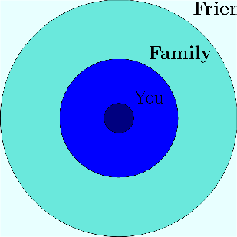
Community
nds
Frie
Make waves!

Slide 42
Scholarly Communication and GenAI
Emily Spracklin, MLIS
Teaching & Learning Librarian, Western Libraries
Notes:
Hi my name is Emily Spracklin. I’m going to be talking about Scholarly Communication and Generative AI.

Slide 43
Scholarly Communication
Creation
Evaluation
Publication
Dissemination & Access
Preservation
Reuse
(Graphic adapted from the University of Winnipeg Libraries, n.d.)
Notes:
Conversations about the impacts of Generative AI in higher education tend to center around student learning, engagement, and academic honesty. But how is generative AI impacting scholarly communication, specifically faculty research, writing, and peer-review practices?
Scholarly Communication refers to the “the system through which research and other scholarly writings are created, evaluated, disseminated, and preserved …” (Association of College and Research Libraries, 2003).
This trailer will describe a small portion of AI’s impacts on three stages of scholarly communication in order to spark interest, prompt critical reflection and action.

Slide 44
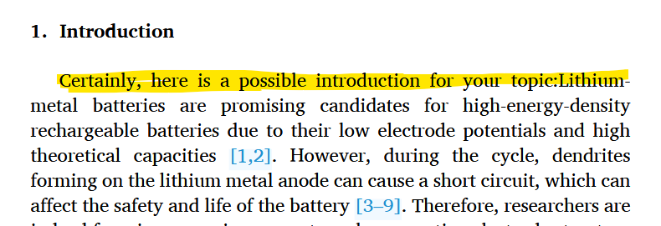
Yes, it’s happening…
(Zhang et al., 2024)
Notes:
So, is generative AI impacting scholarly communication? Absolutely. Yes. This is an egregious example of generative ai showing up in a published, peer-reviewed journal. But how did it happen? And why?

Slide 45
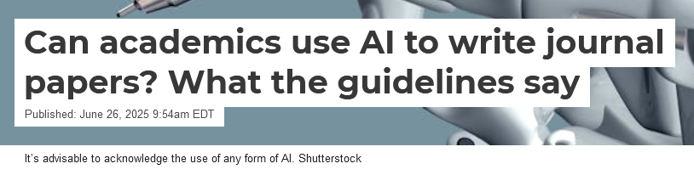
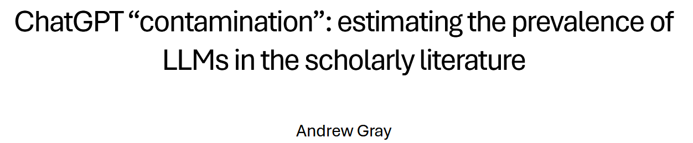

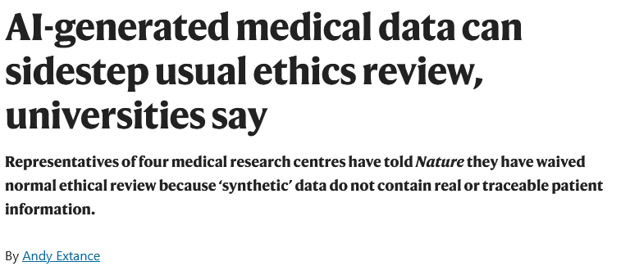
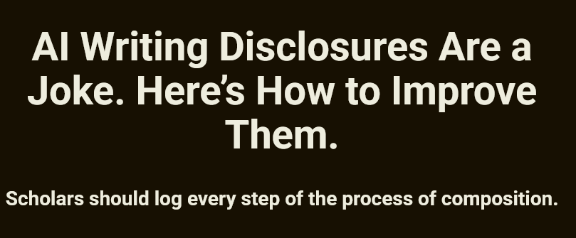
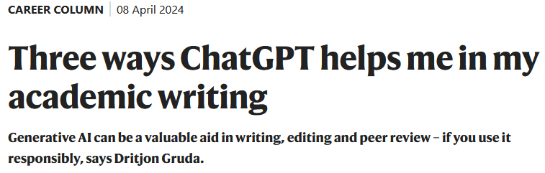
Creation
Notes:
When it comes to information creation, scholars use AI to conduct research, analyze data, draft, proofread and edit manuscripts. However, discourse on this topic centers on writing, specifically identifying ethical uses for AI in writing and developing practices for transparent disclosure (Lahar, 2025).
Disclosure agreements are the primary tool for disclosing AI use, but few researchers are willing to claim they using AI beyond editing and proofreading. Meanwhile large-scale text-analyses suggests researchers continue to use it for content generation purposes (Gray, 2024; Strzelecki, 2025). In reviewing the literature, I observe two contradictory values at play: originality & uniformity. And I wonder to what extent GenAI tools uphold normative, oppressive values in scholarly information creation? In a scholarly landscape dominated by English language content, to what extent do GenAI tools uphold and reinforce monolingualism? Or do they expand access to the scholarly conversation?

Slide 46


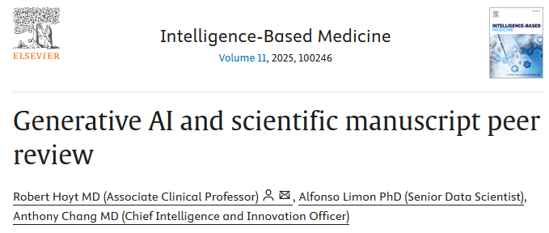
Evaluation
Notes:
When it comes to evaluation, many journals ban the use of GenerativeAI. However, AI generated articles are making it through peer review (Strzelecki, 2025) and peer-reviewers are using GenAI to conduct their reviews (Lo Vechio, 2025; Poissot, 2025).
Proponents of AI argue it’s more objective and assists faculty with their ever-increasing workloads (Hoyt et al., 2025). To counter this position, listen to how one professor described having his work peer-reviewed by an LLM (Poissot, 2025):
“I submit a manuscript for review in the hope of getting comments from my peers. If this assumption is not met, the entire social contract of peer review is gone…I am fully capable of uploading my writing to ChatGPT (I do not ….) So why would I go through the pretense of peer review if the process is ultimately outsourced to an algorithm? …. Using an LLM to write a review is a sign that you want the recognition of the review without investing into the labor of the review.
Zooming out: Consider, How might existing tenure and promotion metrics incentivize the performance of scholarship over scholarly endeavors themselves?

Slide 47
Publication
~60% of total scholarly output is controlled by 5 publishers (Crotty, 2025).
Scholarly publishers license content to GenAI companies like Perplexity, Anthropic, Amazon Web Services, etc. (Ithaka S+R, 2025).
Users will pay more to subscribe to content from these publishers within the GenAI tool (Ithaka S+R, 2025).
Notes:
Publication. The publication of scholarly information is dominated by a handful of publishers who profit from the labor of scholars and public investments in research.
In fact, profit margins for scholarly publishing companies exceed those of more famous tech companies, like Google (Abizadeh, 2024). As publishers increase the price of scholarly information at rates higher than inflation, the institutions, like Western, whose faculty and staff create this information can not afford to access their own content.
So what does GenAI have to do with this, well scholarly publishers like Wiley and Springer have signed contracts licensing their content – your scholarly work - to LLMs. This means publishers are selling your content to these LLMs who then charge or are planning to charge users additional fees to access that body of information.
As much as we discuss “disclosure agreements” and ethical use in writing, we must focus more attention on consent and taking back collective/public ownership of the scholarly conversation. That is, do you consent to your content being licensed to LLMs?

Slide 48

In the library…
Screenshot of Oxford University Press as accessed via Western Libraries
Notes:
In the library today, we see that some publishers are incorporating AI tools into their discovery platforms. Some of these publishers, like Oxford, do not allow institutions to opt-out.
Other platforms, do not allow for a testing environment. That is, the AI tool is either on or off and institutions have no ability to evaluate it’s quality and functionality without making it available to the entire university community.

Slide 49
Looking Ahead
Creation
Evaluation
Publication
Dissemination & Access
Preservation
Reuse
Privacy & Data Security?
Hallucinations?
Retracted papers?
Catastrophic Forgetting?
Replicability?
Transparency?
(Graphic adapted from the University of Winnipeg Libraries, n.d.)
Notes:
To discuss and learn more about, GenAI’s impacts on the dissemination, preservation, and reuse of scholarly information please attend a future teach-in!!!

Slide 50
So what?
To what extent do GenAI tools uphold normative, oppressive values in scholarly information creation?
Do GenAI tools reinforce monolingualism? Or do they expand access to the scholarly conversation?
How might existing tenure and promotion metrics incentivize the performance of scholarship over scholarly endeavors themselves?
Do you consent to your content being licensed to LLMs?
Creation
Evaluation
Publication
Dissemination & Access
Preservation
Reuse
Notes:
In the meantime, consider these questions!

Slide 51
References
Abizadeh, A. (2024, July 16). Academic journals are a lucrative scam – and we’re determined to change that. The Guardian. https://www.theguardian.com/commentisfree/article/2024/jul/16/academic-journal-publishers-universities-price-subscriptions
Association of College and Research Libraries (ACRL). (2003). Scholarly Communication Overview [LibGuides]. Scholarly Communication Toolkit. https://acrl.libguides.com/scholcomm/toolkit/home
Crotty, D. (2025, August 20). 2025 Update: Quantifying Consolidation in the Scholarly Journals Market. The Scholarly Kitchen. https://scholarlykitchen.sspnet.org/2025/08/20/2025-update-quantifying-consolidation-in-the-scholarly-journals-market/
Extance, A. (2025). AI-generated medical data can sidestep usual ethics review, universities say. Nature. https://doi.org/10.1038/d41586-025-02911-1
Gray, A. (2024). ChatGPT “contamination”: Estimating the prevalence of LLMs in the scholarly literature (No. arXiv:2403.16887). arXiv. https://doi.org/10.48550/arXiv.2403.16887
Gruda, D. (2024). Three ways ChatGPT helps me in my academic writing. Nature. https://doi.org/10.1038/d41586-024-01042-3
Hartberg, Y. (2025, August 15). AI Writing Disclosures Are a Joke. Here’s How to Improve Them. The Chronicle of Higher Education. https://www.chronicle.com/article/ai-writing-disclosures-are-a-joke-heres-how-to-improve-them
Hosseini, M., Gordijn, B., Kaebnick, G. E., & Holmes, K. (2025). Disclosing generative AI use for writing assistance should be voluntary. Research Ethics, 17470161251345499. https://doi.org/10.1177/17470161251345499
Hoyt, R., Limon, A., & Chang, A. (2025). Generative AI and scientific manuscript peer review. Intelligence-Based Medicine, 11, 100246. https://doi.org/10.1016/j.ibmed.2025.100246
Ithaka S+R. (2025). Generative AI Licensing Agreement Tracker. Ithaka S+R. https://sr.ithaka.org/our-work/generative-ai-licensing-agreement-tracker/
Laher, S. (2025, June 26). Can academics use AI to write journal papers? What the guidelines say. The Conversation. http://theconversation.com/can- academics-use-ai-to-write-journal-papers-what-the-guidelines-say-258824
Lo Vecchio, N. (2025). Personal experience with AI-generated peer reviews: A case study. Research Integrity and Peer Review, 10, 4. https://doi.org/10.1186/s41073-025-00161-3
Poissot, T. (2025, February 10). Vol. 24—Here is a revised version of your review with improved clarity. CTRL.ALT.TIM. https://buttondown.com/ctrl-alt- tim/archive/vol-24-here-is-a-revised-version-of-your-review/
Strzelecki, A. (2025). ‘As of my last knowledge update’: How is content generated by ChatGPT infiltrating scientific papers published in premier journals? Learned Publishing, 38(1), e1650. https://doi.org/10.1002/leap.1650
Zhang, M., Wu, L., Yang, T., Zhu, B., & Liu, Y. (2024). The three-dimensional porous mesh structure of Cu-based metal-organic-framework—Aramid cellulose separator enhances the electrochemical performance of lithium metal anode batteries. Surfaces and Interfaces, 46, 104081. https://doi.org/10.1016/j.surfin.2024.104081

Slide 52

Privacy and Ethics Claudia Johnson JD, MPP, MPH Law Diversity and Justice Center Fairhaven College john567@wwu.edu

Slide 53

Hypotheticals
State of Regulation
State Level
Federal Level
Resources

Slide 54

HYPOS IS YOUR PRIVACY PROTECTED BY AI TOOLS? ARE YOU FINDABLE? CAN YOUR WORK BE REUSED W/OUT COMPENSATION?

Slide 55

WHERE YOU ARE MATTERS WHAT TOOL YOU ARE ON MATTERS TOO
Location Location Location in the absence of Federal Regulation

Slide 56

WHAT CREDIBLE/NEUTRAL EMPIRICAL EVIDENCE DO WE HAVE THAT AI TOOLS WORK?
“They used to ask: “How will this decision that we make today affect our people in the future.” Now we make decisions based on :”How does it affect me now? How does it affect the next shareholders meeting, three months ahead? How does it affect my next political campaign”--Jane Goodall

Slide 57

PRIVACY
Illinois/CA have more state level regulation
In WA State, there have been attempts to increase protections, but they have not yet succeeded, but also industry bills have not passed--detente
Third party liability causes in terms of use
Theory of unjust enrichment
Private right to sue as an individual—mostly not
“AI Bill of Rights”—no longer being pursued, instead WH is now pursuing “Winning the Race” in AI

Slide 58


Pressure to ban State Level Regulation—removed 99-1 BBB

Slide 59

“Winning the Race” new White House blueprint
The Plan identifies over 90 Federal policy actions across three pillars – Accelerating Innovation, Building American AI Infrastructure, and Leading in International Diplomacy and Security – that the Trump Administration will take in the coming weeks and months.
Key policies in the AI Action Plan include:
Exporting American AI: The Commerce and State Departments will partner with industry to deliver secure, full-stack AI export packages – including hardware, models, software, applications, and standards – to America’s friends and allies around the world.
Promoting Rapid Buildout of Data Centers: Expediting and modernizing permits for data centers and semiconductor fabs, as well as creating new national initiatives to increase high-demand occupations like electricians and HVAC technicians.
Enabling Innovation and Adoption: Removing onerous Federal regulations that hinder AI development and deployment, and seek private sector input on rules to remove.
Upholding Free Speech in Frontier Models: Updating Federal procurement guidelines to ensure that the government only contracts with frontier large language model developers who ensure that their systems are objective and free from top-down ideological bias.
https://www.whitehouse.gov/articles/2025/07/white-house-unveils-americas-ai-action-plan/

Slide 60

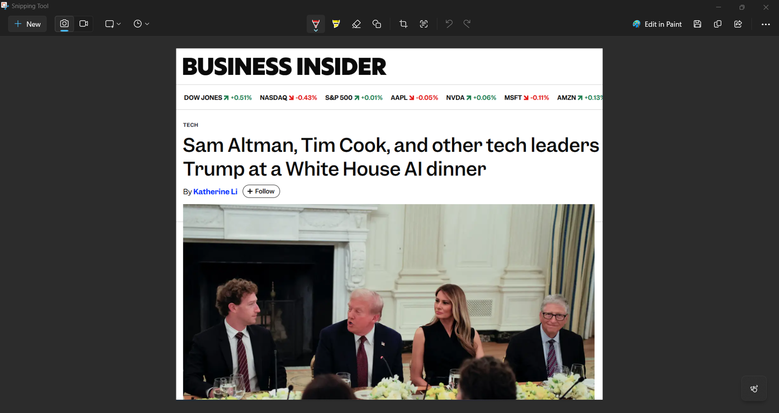
Tech Moguls met at WH on 9/5/2025

Slide 61

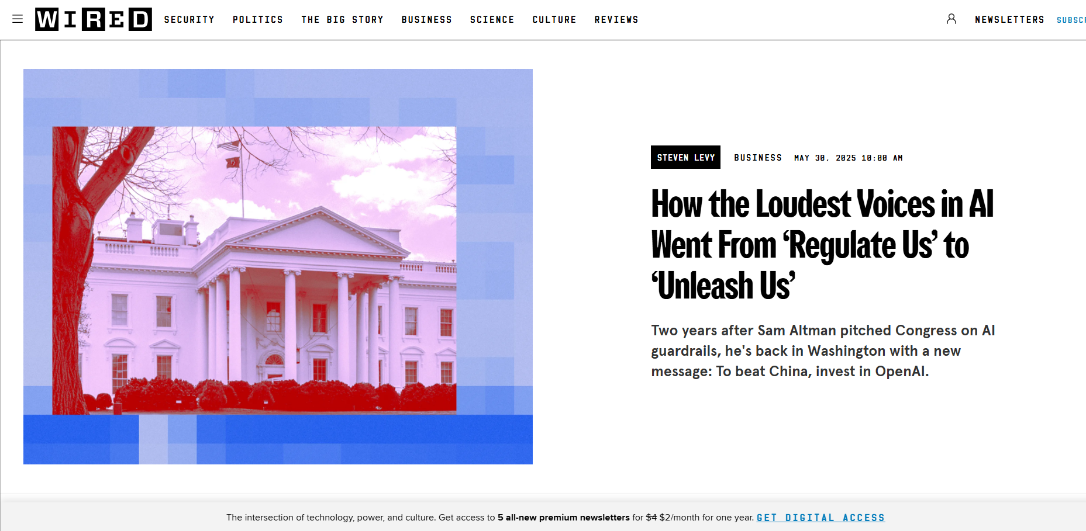
From “Regulate us” to “unleash Us”

Slide 62
Ethics
What does your user need to know?

Slide 63
ETHICS VARY BY COMMUNITY/DOMAIN
Professional ethics
Personal ethics
Access to services/multiple options
Option to opt out and still be able to receive service at the beginning and throughout the work flow
Full disclosure of data sharing (what, how long, with whom, data sale, notifications if hacked or subpoenaed
Right to request full review of your data/records
Avatars
Can the platform create your likeness w/out your consent?
Can that likeness act on your behalf?
Can they use your entries, questions, and profile to develop new tools? Train machines, new output?

Slide 64
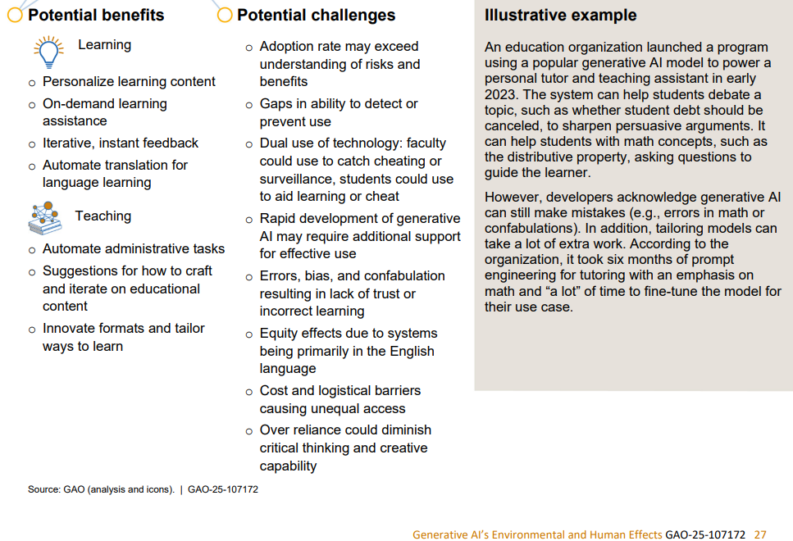
AI IN EDUCATION PROS AND CONS

Slide 65
Standards, what do users need to feel secure in using XYZ tool?
Right to opt out
Right to deny data sharing
Right to report errors/issues and have rapid resolution
Right to sue if harmed (including having your work used to produce output or train the system)
What you upload is yours, not theirs/ownership
What should these look like for a public university? Professors? Advisors? Students?

Slide 66

Resources
4th Amendment and surveillance, The Fourth Amendment in the Digital Age Laura Hecht –Felella
Orrick, AI tracker, https://ai-law-center.orrick.com/illinois/
The biggest data breach fines, penalties, and settlements so far, Jan 8, 2025 Michael Hill and Shweta Sharma
ABA. Standards for the Provision of Civil Legal Aid, Standing Committee on Legal Aid and Indigent Defense, 4.10 Effective Use of Technology

Slide 67

GENERATIVE AI: CLIMATE IMPACTS
XI WANG, MS, PHD
Department of Environmental Studies Institute for Energy Studies

Slide 68



Capital-intensive Investments & The Momentum Of Energy Infrastructures
Construction of a coal power plant
Photo: Xi Wang

Slide 69
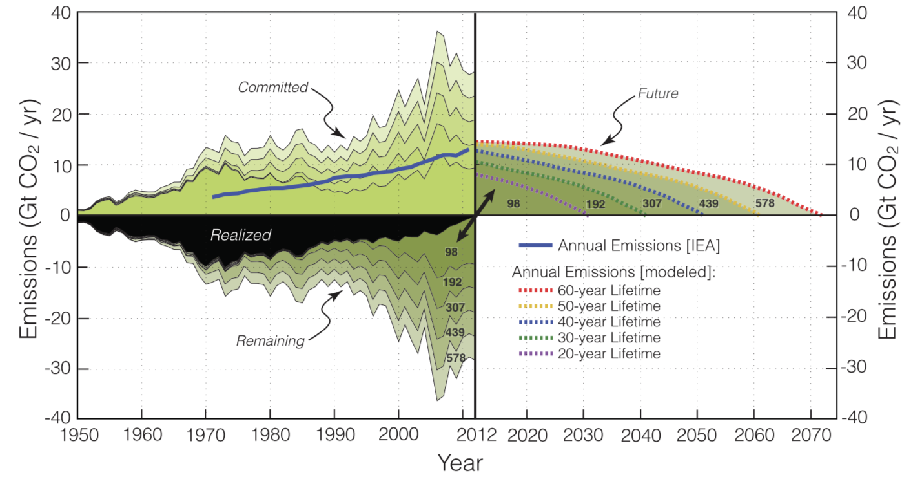
Global Committed Emissions Of Fossil Fuel-fired Power Plants, 1950-2070
L: Global Committed Emissions of Fossil Power Plants, 1950-2014 R: Global Committed Emissions Projected to 2070, dependent on the length of power plant lifetimes
Source: Davis & Socolow, 2014, Commitment Accounting of CO2 Emissions

Slide 70
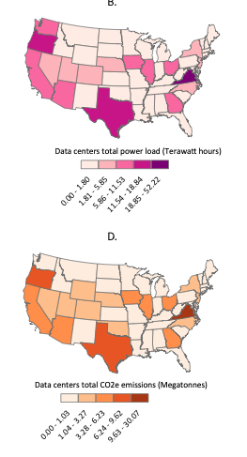
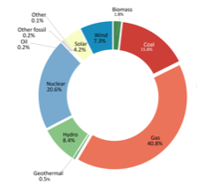
How much power do data centers use? Where does that power come from? What are the climate impacts?
Power Load for 2,100+ U.S. data center, 2023-2024
Power Generation Sources for 2,100+ U.S. data centers
CO2 Emissions for 2,100+ U.S. data centers, 2023-2024
70
Sources: Guidi et al, 2024, Environmental Burden of United States Data Centers in the Artificial Intelligence Era

Slide 71
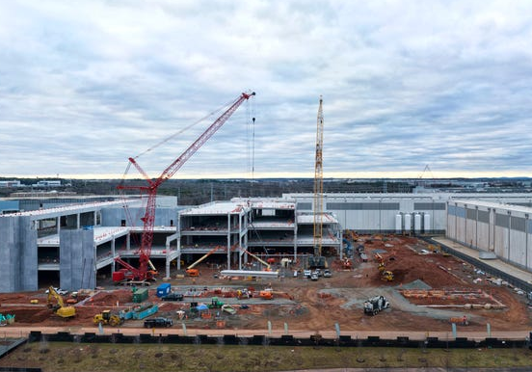
The Momentum of Industrial Investments: How are you paying for this?
Construction of an AI Data Center
L: Global Committed Emissions of Fossil Power Plants, 1950-2014 R: Global Committed Emissions Projected to 2070, dependent the length of power plant lifetimes
Photo: Getty Images, 2023; Source: Davis & Socolow, 2014, Commitment Accounting of CO2 Emissions

Slide 72
RESOURCES
MIT News. “Explained: Generative AI’s Environmental Impact” Series: https://news.mit.edu/2025/explained-generative-ai-environmental-impact-0117
More Perfect Union. ”Big Tech Takeovers” Series: https://perfectunion.us
72

Slide 73
Worksheet Questions
How does genAI affect the way work members of your group do at WWU? Do you use it? How? Why? Do you refuse it? Why?
What is one fear or nightmare each person in your group has when it comes to genAI in education? What is one dream or hope that you have?
Of all the topics you heard about today, which ones do your group members most want to dive deeper into at a future teach in? Why?
Of all the topics you hear about today, what is one important topic that your group members think was missing? Describe it. Why is it important to you?

Slide 74
Popcorn Prompts
One genAI in education nightmare
One genAI in education dream
One idea for a future teach in topic

Slide 75
Ways to stay involved
Emails:
Jenny Forsythe (fosytj3@wwu.edu)
Amites Sarkar (sarkara@wwu.edu)
Emily Spraklin (sprake@wwu.edu)
Claudia Johnson (john567@wwu.edu)
Xi Wang (xi.wang@wwu.edu)
Aspen Clark (clarkm34@wwu.edu)
Robyn Dahl (dahlr4@wwu.edu)
Brianna Delker (delkerb@wwu.edu)
Christine Johnson (christine.johnson@wwu.edu)
Sign up for our “Critical AI Literacies Collective” list-serv
Email one of today’s speakers for details on the next teach-in planning meeting
Stay in the room for a bit and continue chatting!

